Slide 1
MONOD: Methylation Haplotype in non-invasive Cancer Diagnosis
Shicheng Guo @ Zhang Lab
July 22 2015
Notes:
Hello, everyone, today I will introduce the progress of the mond project which is shorted for Methylation Haplotype in non-invasive Cancer Diagnosis

Slide 2
MONOD: Methylation Haplotype in non-invasive Cancer Diagnosis
Background
Material and Method
Result
Conclusion
Future work
Notes:
I will introduce this project as the following pipeline. First, let’s start with some background.

Slide 3
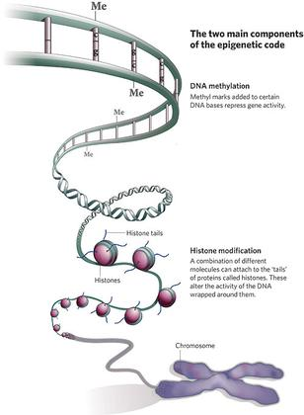
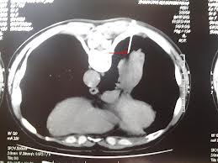
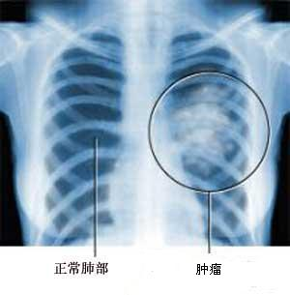
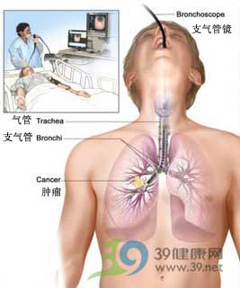
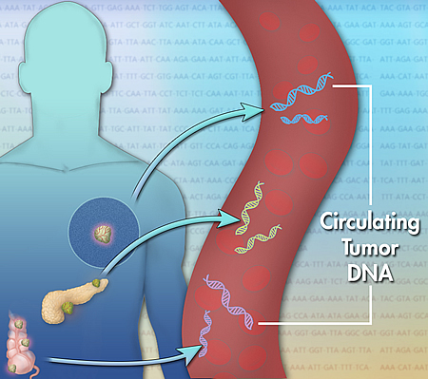
Background: DNA methylation in Cancer Diagnosis
Early Detection
Non-invasive
Prognosis
Surveillance
Drug Selection
Thomas F. Imperiable, etc. The new England Journal of Medicine. 2015
Notes:
All of us know what’s cancer and what’s DNA methylation, therefore, I do not need to talk more about these two concept. What I need to introduce is the potential role of DNA methylation in the diagnosis of cancers. Long time cancer therapy research showed the most efficient method to decrease the death of the cancer is to diagnosis cancer as early as we can.

Slide 4
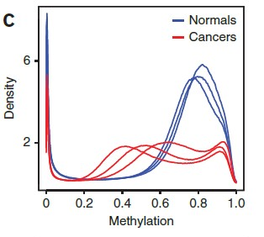
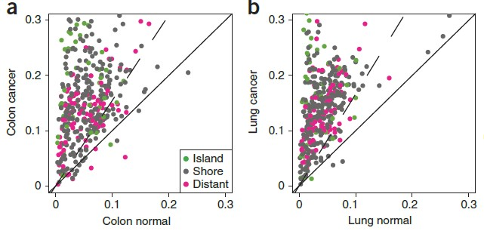
Genome-wide DNA methylation change in cancer genomes
Variance
Genome-wide hypomethylation in cancer genome
Hypermethylation in tumor suppressor genes
Methylation variation explain cancer heterogeneity
Biomarker identified by solid tissues
Genome-wide DNA methylation profile in cell-free circulating DNA
Hansen KD, et al. Nature genetics. 2011;43(8):768-75.
Notes:
The characteristics of DNA methylation in cancer are included genome-wide hypomethylation and hypermethylation in tumor suppressor genes. In addition, Methylation variation could explain cancer heterogeneity. However, till now, most methylation based cancer biomarker are derived from solid tissue. In the clinical practice, it is useless. In this study, we obtained genome-wide DNA methylation profile in cell-free circulating DNA with 3 kinds of method and we want to identify some cancer biomarker which is based on cell-free circulating DNA and evaluate its prediction performance.

Slide 5
MONOD: Methylation Haplotype in non-invasive Cancer Diagnosis
Background
Material and Method
Result
Conclusion
Future work

Slide 6
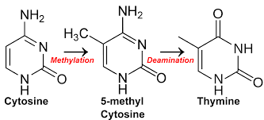
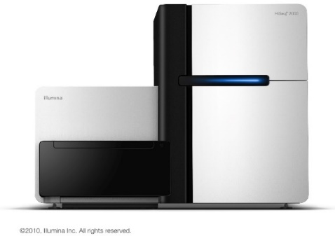
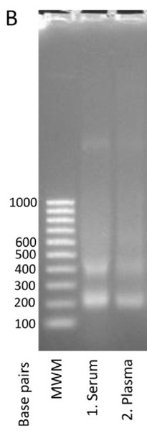
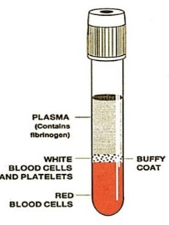
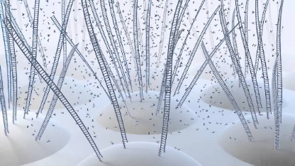
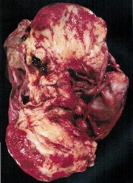
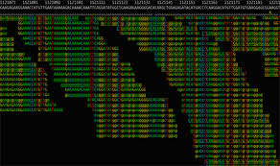
Pipeline
Solid Tissues
Plasma Collection
DNA Extraction
Bisulfite Conversion
DNA Sequencing
Alignment
Quality Control
Haplotype inference
Missing value imputation
Feature Selection
Validation
Sequencing Library: RRBS, BSPP, SeqCap

Slide 7
Samples
Cancer:
Normal:
15 primary lung cancer solid tissues and 10 plasma (5 overlapped)
15 primary Colon cancer solid tissues and 10 plasma (5 overlapped)
15 primary Pancreatic cancer solid tissues and 10 plasma (5 overlapped)
30 plasma from health individuals
N37: 37 normal tissues form Jin Billy Li, Standford Univ
Aging: WB_new-born, WB_middle-age, WB_centenarian
Data Structure: methylation data of cfc-DNA
July 2014
Sep 2014
Dec 2014
Feb 2015
Feb 2015
RRBS
dRRBS
WGBS1
WGBS2
BSPP
68 Cancer
8 Normal
0 Cancer
17 Normal
19 Cancer
1 Normal
31 Cancer
24 Normal
16 Cancer Plasma
16 Normal Plasma

Slide 8
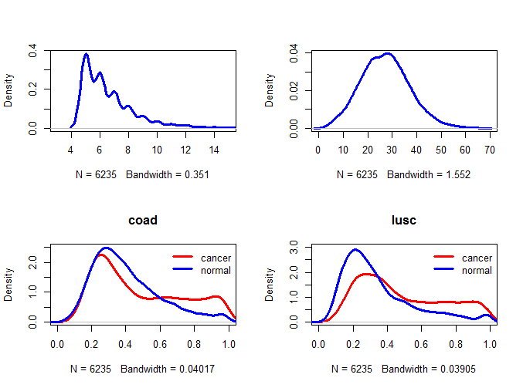

Slide 9
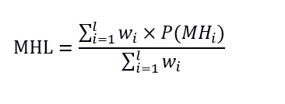
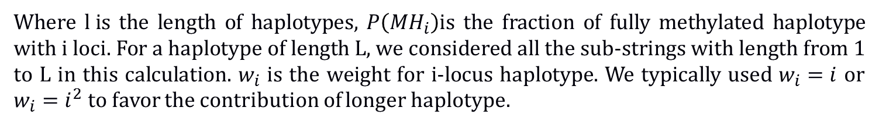
Methylated Haplotype Loading (MHL) for a genome region
Where $l i$s the length of haplotypes, $P\left({MH}_{i}\right)$is the fraction of fully methylated haplotype with i loci. For a haplotype of length L, we considered all the sub-strings with length from 1 to L in this calculation. $w_{i}$ is the weight for i-locus haplotype. We typically used $w_{i}=i$ or $w_{i}=i^{2}$ to favor the contribution of longer haplotype.
1, MHL is the unbiased estimate of methylation for a genome region
2, MHL ranges from 0 to1
Shoemaker R, Deng J, Wang W, Zhang K. Genome research. 2010;20(7):883-9
Notes:
MHL is the unbiased estimate of methylation for a genome region and MHL ranges from 0 to1

Slide 10
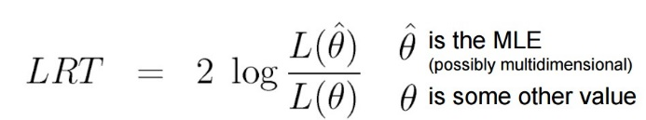
Methylated Haplotype (Load) based biomarker
Likelihood-ratio test
Monte Carlo sampling/permutation
P(A)=1-P(x<a)
LRT has a Chi-Square Distribution
Methylated Haplotype based biomarker can be used to detect hyper-methylated fragment in low concentration

Slide 11
MONOD: Methylation Haplotype in non-invasive Cancer Diagnosis
Background
Material and Method
Result
Conclusion
Future work

Slide 12
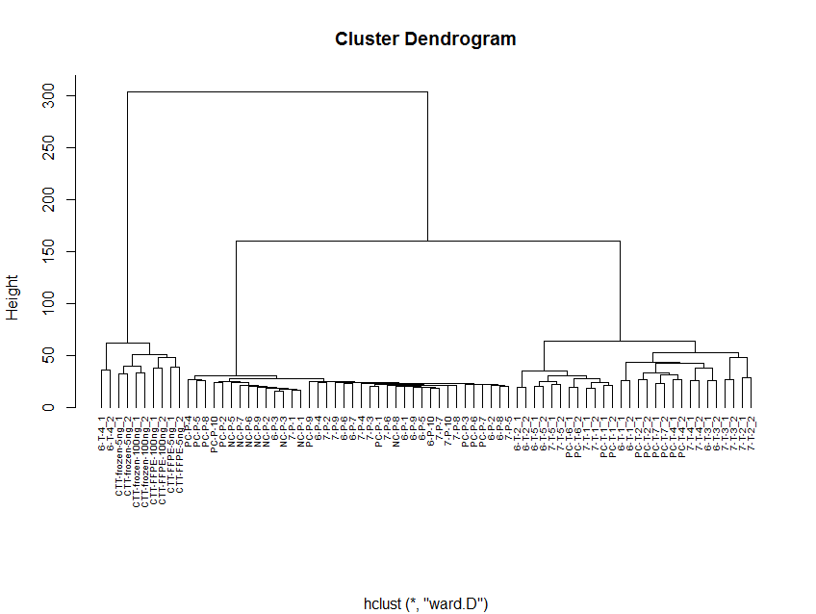
56046
Genome-wide MHL Profile Indicates Different Sample Types and Sample Status
Dataset: RRBS
Sample Size: 68 cancer and 8 normal
Genomic region: 50646 MHRs
Long Storage Plasma Solid Tissue
Accuracy:80% Accuracy:100% Accuracy:100%
Result: Cluster analysis showed genome-wide MHL based on RRBS dataset could distinguish sample size with very high accuracy. Cluster analysis were conducted with euclidean distance and ward agglomeration.
Notes:
This figure is cluster analysis to genome-wide MHL profile for RRBS dataset. In the figure, all the samples are clustered into 3 groups which include solid tissue, plasma tissue and formalin fixed samples. The accuracy is very high. Only 2 solid tissues sample were grouped into formalin-fix cluster, which I think these samples might be stored for long time.
Data: RRBS MHL data
Process:Raw data, no center and no scale
Distance fumula:euclidean
agglomeration method: ward

Slide 13
Principle Component Analysis reveal the relationship between samples
based on RRBS dataset
The first principle component is significantly larger than the other PCs indicating certain factor might highly variant among the samples
Sample status of cancer or normal could be distinctly separated in the PC1-PC2 space
Notes:
左上角的四对组织可能是FFPC

Slide 14
Significant differential MHL region preferred intergenic region
843 significant differential MHL regions were identified between cancer and normal (P<9.8*10⁻⁷)
Differential MHL
Whole MHL
Discrete
Number of associated genes
The significant differential MHL region have more regions far from TSS are therefore have more proportion regions without associated gene
Notes:
After the view of the genome-wide data, we want to check the differential MHL regions between cancer and normal. We obtained 843 significant regions and we found these regions were preferred to intergenic region.

Slide 15
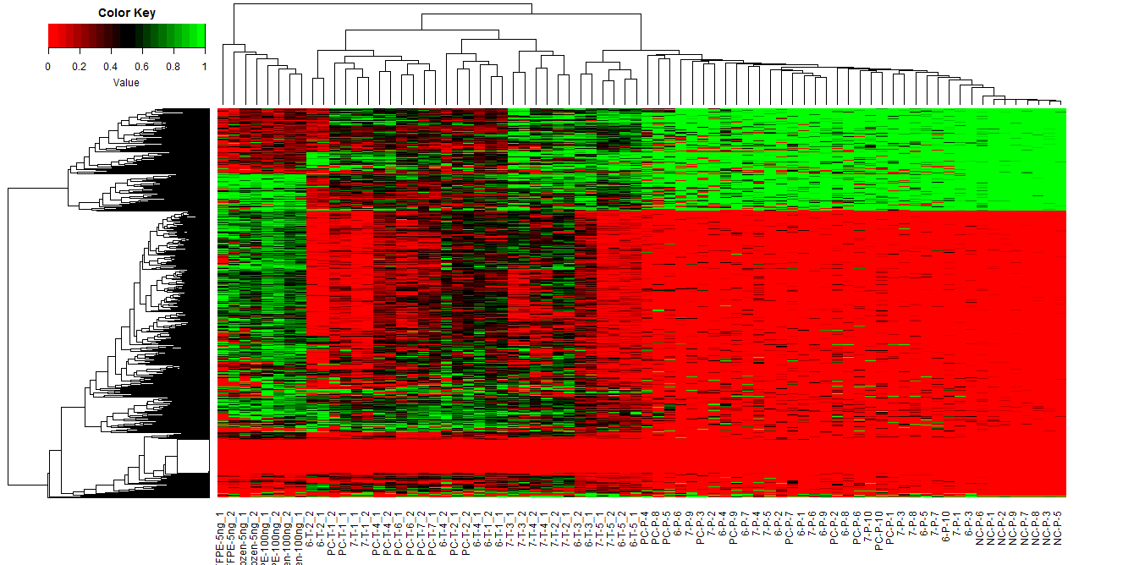
Differential MHL region Profile Indicates Different Sample Types
843 Differential MHL regions
Formalin-fixed paraffin-embedded (FFPE)
ACC: Accuracy
FFPE Solid Tissue Cancer Plasma Normal Plasma
ACC=100% ACC=100% ACC=100% ACC=100%
Result: Methylation Haplotype Loading is informative to indicate sample type and sample status
Notes:
Cluster analysis based on differential

Slide 16
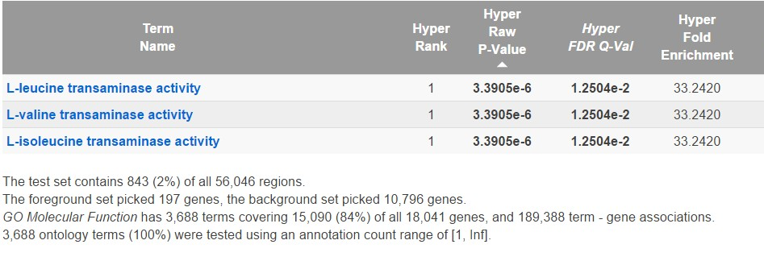
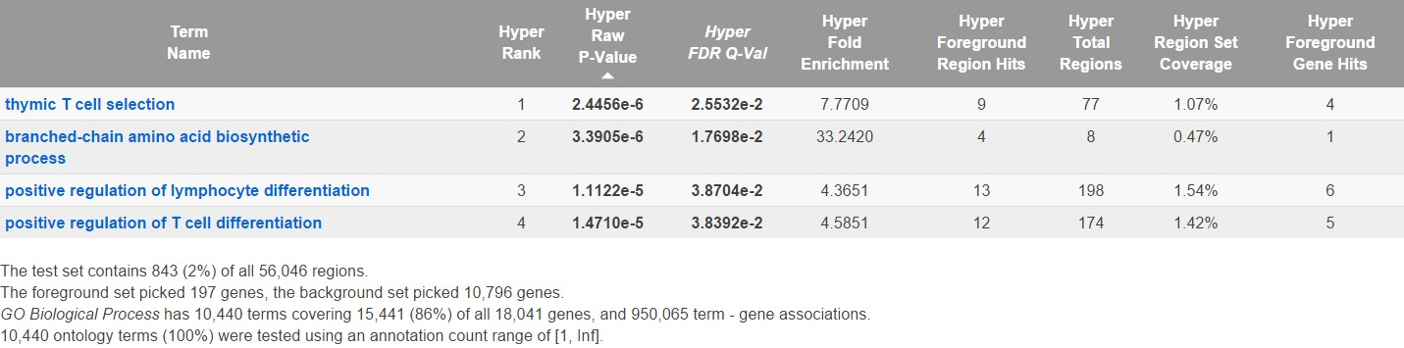
Gene ontology analysis reveal metabolism and immunology related module aberrant
GO Biological Process
metabolism
GO Cellular Component
immunology
Target: 843 significant MHL regions
Background: 50646 methylation haplotype regions

Slide 17

3 enriched gene family
PCDHN (Fold enrichment=9.5, P=1.6*10-4), NKL (FE=3.5, P=1.9*10-4) and MLNR (22.16, P=2.7*10-4) gene family were significantly enriched in the differential MHL regions in RRBS dataset. These three gene family are related with morphogenesis, cell-movement and cytoskeleton.
Protocadherins: The protocadherin (PCDH) gene family encodes proteins with an ectodomain comprising six or seven cadherin repeats with high sequence conservation within the family and weaker homology to the cadherin repeats of members of the major cadherin family. Further, protocadherins have a single transmembrane domain and a distinct, protocadherin-specific, cytoplasmic domain. Protocadherins can be further subdivided into clustered and non-clustered protocadherins on the basis of particular genomic organizations. [Source: Roy & Hulpiau, Feb 2010]
NKL: GLI-similar zinc finger protein family and encodes a nuclear transcription factor with five C2H2-type zinc finger domains. The protein encoded by this gene is widely expressed at low levels in the neural tube and peripheral nervous system and likely promotes neuronal differentiation. It is abundantly expressed in the kidney and may have a role in the regulation of kidney morphogenesis. p120 regulates the expression level of this protein and induces the cleavage of this protein's C-terminal zinc finger domain. This protein also promotes the nuclear translocation of p120. Mutations in this gene cause nephronophthisis (NPHP), an autosomal recessive kidney disease characterized by tubular basement membrane disruption, interstitial lymphohistiocytic cell infiltration, and development of cysts at the corticomedullary border of the kidneys.[provided by RefSeq, Jan 2010] (from NCBI)
movement

Slide 18
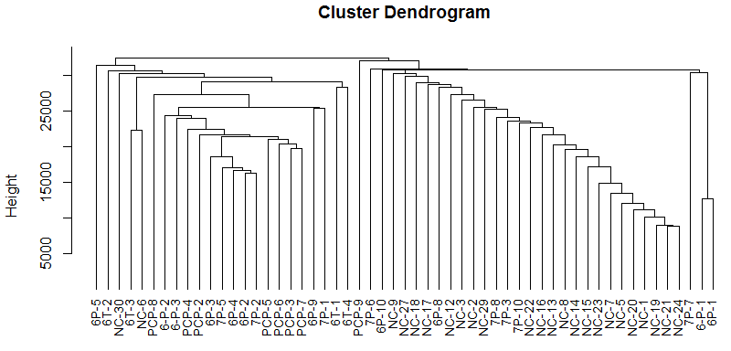
Methylation Haplotype Loading Profile in Plasma based on SeqCap
Cancer Normal
Sensitivity=67.74% Specificity=91.66%
Result: Cluster analysis based on MHL matrix of SeqCap dataset on 31 cancer and 24 normal showed the samples were clustered into two groups simultaneously. The Specificity is greatly higher than sensitivity indicate large number of biomarkers in SeqCap are hypomethylated and it was consistent with later analysis.
Cluster analysis were conducted with Manhattan distance and complete agglomeration.

Slide 19
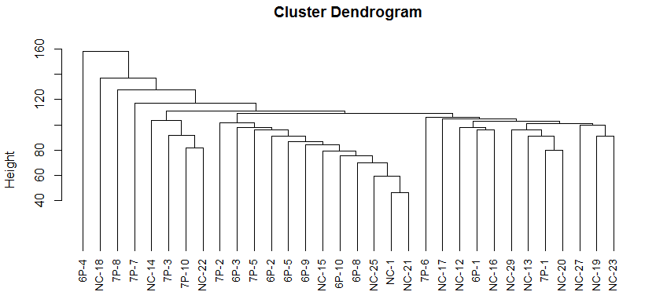
Methylation Haplotype Loading Profile in Plasma based on BSPP
P: Plasma
NC: Normal
6: Colon
7: Lung
Sensitivity=87.5% Specificity=62.5%
Result: Cluster analysis based on MHL matrix of BSPP dataset on 16 cancer plasma and 16 normal plasma showed normal plasma sample have high similarity and would agglomerate together. However, some normal plasma samples were clustered into the cancer subgroup which indicated we selected too many genome-regions which were hypermethylated both in cancer and normal tissues. In next step, we will select more specific biomarkers with feature selection operation. Cluster analysis were conducted with Manhattan distance and complete agglomeration.

Slide 20
Principle Component Analysis reveal the relationship between samples
based on Capseq dataset

Slide 21
Principle Component Analysis reveal the relationship between samples
based on BSPP dataset

Slide 22
Efficiency of different method in identifying biomarkers
N37 + WB + WGBS + SeqCap + BSPP
N37 + WB + WGBS + RRBS + dRRBS
6986
5049
RRBS+dRRBS
1007
BBSP+SeqCap
 | P-value | Delta>0 | normal<0.3 | normal<0.2
RRBS + dRRBS | 109 | 36 (33%) | 36(33%) | 36(33%)
SeqCap + BSPP | 15 | 15 (100%) | 13(86%) | 8(53%)
RRBS can identify more differential methylation biomarkers.
BSPP can identify useful biomarker with higher efficiency and specificity
Notes:
12.6%-16.6% blocks are intersected between these two methods. meanwhile, there are only 20%-29% regions were shared in these two methods.

Slide 23
Performance of prediction with different detection method
N37 + WB +WGBS + SeqCap + BSPP
 | Train |  |  | test
 | Specificity | sensitivity | accuracy | specificity | sensitivity | accuracy
Random forest | 1.000 | 1.000 | 1.000 | 0.855 | 0.974 | 0.951
Recursive partitioning trees | 1.000 | 0.977 | 0.982 | 0.906 | 0.892 | 0.895
Support vector machine | 0.900 | 0.976 | 0.961 | 0.900 | 0.975 | 0.961
N37 + WB + WGBS + RRBS + dRRBS
 | train |  |  | test
 | specificity | sensitivity | accuracy | specificity | sensitivity | accuracy
Random forest | 1.000 | 1.000 | 1.000 | 0.911 | 1.000 | 0.979
Recursive partitioning trees | 0.956 | 0.971 | 0.967 | 0.893 | 0.928 | 0.920
Support vector machine | 1.000 | 1.000 | 1.000 | 0.930 | 0.995 | 0.980
Limitation:
Larger number of missing value in the merged dataset and imputation was applied which would induce uncertainty for the biomarker identification.

Slide 24
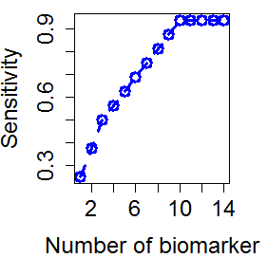
Performance of prediction evaluated with two stage method
 | RRBS | SeqCap | BSPP
Total | 56046 | 86206 | 36281
100% un-methylated | 17263 | 2205 | 4194
Informative in RF | 1592 | 516 | 1585
RRBS: Sensitivity of 97.06%, Specificity of 100% and Accuracy of 97.37%
SeqCap: Sensitivity of 87.1%, Specificity of 75.0% and Accuracy of 81.26%
RRBS
SeqCap
1592
516
BSPP
30 regions
(24 gene)
1585
These 30 regions could explain 93.75% cancers incidence with the specificity of 100%.
Notes:
These 30 regions were located in the promoter or gene body of 24 genes, including FGF19, MEF2C-AS1, MEF2C, HABP2, AGO3, TAF15, ZWILCH, YTHDF3-AS1, ZNF213, C9orf114, C14orf28, ADAM11, CDKN2AIP, TMEM87B, CDKL3, MSH5, MSH5-SAPCD1, UBC, PCM1, PCK2, NR2F6, JADE2, KANK1 and MCM3. At least 12 genes have been demonstrated to be associated with human cancers with the annotation from NCBI (HABP2, FGF19, MEF2C, AGO3, CDKL3, MCM3, TAF15, PCK2, NR2F6, MSH5, ZWILCH and PCM1). For example, the FGF19-FGFR4 signaling axis has been implicated in the pathogenesis of several cancers in mice and potentially in humans (7) while HABP2 has been found to be hypermethylated in hepatocellular carcinomas cancer (8). AGO3 was found significant decreased in human liver cancer (9). KANK1 re-expression induced by 5-Aza-2'-deoxycytidine could suppresses nasopharyngeal carcinoma cell proliferation and promotes apoptosis (10). Whole-exome sequencing identifies mutated PCK2 associated with carcinoma cell proliferation in a hepatocellular carcinoma patient(11)

Slide 25
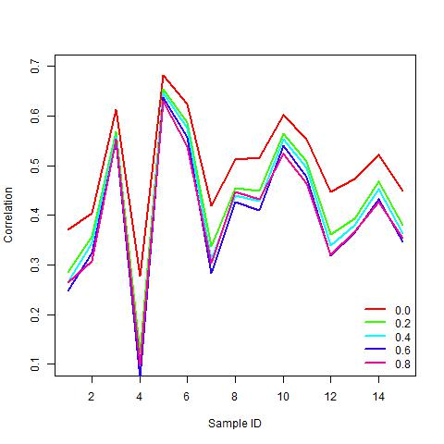
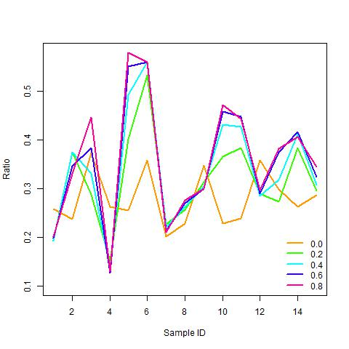
Correlation of the MHL between solid tissue and matched plasma
15 samples were measured both in solid tissues and plasma
Correlation of the MHL between tissue and plasma ranges from 0.1 to 0.7. And there is no significant difference among fragments of different methylation levels.
Averagely, only about 30% hyper-methylated regions in solid tissues can be detected in plasma. And the variation between different sample is very large.

Slide 26
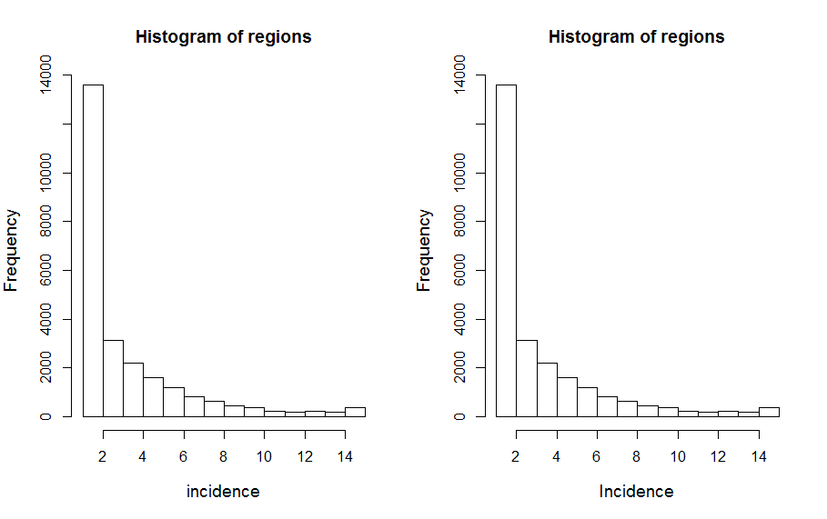
The process of DNA methylation releasing is non-random event
25204 regions which was methylated in sample pairs for at least one time were selected to evaluate the selectivity of hyper-methylated DNA fragments from solid tissues to plasma. The results showed the process of the releasing were non-random, with at least 1590 fragment were significantly prefer-selected (P<1.98*10⁻⁶, binomial test, Bonferroni correction).
Chrosome | Start | End | P-value | Gene Symbol
chr7 | 148844549 | 148845661 | 1.60838E-09 | ZNF398
chr15 | 45694686 | 45695770 | 4.73217E-11 | SPATA5L1
chr7 | 2394352 | 2395434 | 1.60838E-09 | EIF3B
chr20 | 34541826 | 34542761 | 6.57404E-07 | SCAND1
chr3 | 120067253 | 120068270 | 6.57404E-07 | LRRC58
chr2 | 223725830 | 223726761 | 6.57404E-07 | ACSL3
chr2 | 99771397 | 99772330 | 3.79223E-08 | LIPT1
chr4 | 6717680 | 6718723 | 1.60838E-09 | BLOC1S4
chr13 | 77459256 | 77460137 | 7.35884E-15 | KCTD12
chr9 | 88713677 | 88714554 | 4.73217E-11 | GOLM1
chr9 | 99212506 | 99213315 | 4.73217E-11 | HABP4
chr4 | 147096784 | 147097642 | 3.79223E-08 | LSM6
chr6 | 35995636 | 35996426 | 1.60838E-09 | MAPK14
chr6 | 84743476 | 84744245 | 6.57404E-07 | MRAP2
chr22 | 21739186 | 21739949 | 7.35884E-15 | RIMBP3C
chr22 | 21739186 | 21739949 | 7.35884E-15 | RIMBP3B
chr1 | 153747608 | 153748527 | 6.57404E-07 | SLC27A3
chr16 | 2022013 | 2022814 | 1.60838E-09 | TBL3
chr22 | 38477084 | 38477826 | 4.73217E-11 | SLC16A8
chr2 | 224903190 | 224903928 | 1.60838E-09 | SERPINE2
1590 fragment
P<1.98*10⁻⁶
Notes:
Here, I need take T-MHL and do it again.

Slide 27
Gene Function enrichment analysis of over-selected plasma methylated genes
Category | Term | P-Value | Fold Enrichment | FDR
SP_PIR_KEYWORDS | phosphoprotein | 4.06E-09 | 1.235360565 | 5.89E-06
SP_PIR_KEYWORDS | alternative splicing | 2.64E-08 | 1.216514173 | 3.83E-05
UP_SEQ_FEATURE | splice variant | 6.29E-08 | 1.209681234 | 1.12E-04
UP_SEQ_FEATURE | compositionally biased region:Pro-rich | 8.04E-08 | 1.802578204 | 1.43E-04
UP_SEQ_FEATURE | compositionally biased region:Poly-Ala | 4.21E-07 | 2.27583422 | 7.50E-04
GOTERM_MF_FAT | GO:0003700~transcription factor activity | 5.35E-07 | 1.692075365 | 8.36E-04
UP_SEQ_FEATURE | DNA-binding region:Homeobox | 4.79E-07 | 2.967698238 | 8.54E-04
GOTERM_BP_FAT | GO:0048598~embryonic morphogenesis | 5.06E-07 | 2.383470989 | 9.10E-04
SP_PIR_KEYWORDS | metal-binding | 6.54E-07 | 1.374657713 | 9.48E-04
SP_PIR_KEYWORDS | dna-binding | 7.39E-07 | 1.496429489 | 0.001071936
SP_PIR_KEYWORDS | transcription regulation | 1.57E-06 | 1.456916287 | 0.002275867
GOTERM_BP_FAT | GO:0045449~regulation of transcription | 1.52E-06 | 1.358592545 | 0.002730545
INTERPRO | IPR012287:Homeodomain-related | 2.15E-06 | 2.541101589 | 0.003540582
SP_PIR_KEYWORDS | Transcription | 3.48E-06 | 1.434698292 | 0.005053555
SP_PIR_KEYWORDS | zinc | 5.49E-06 | 1.410939583 | 0.007967203
SP_PIR_KEYWORDS | Homeobox | 6.55E-06 | 2.504052442 | 0.009502956
SP_PIR_KEYWORDS | nucleus | 7.08E-06 | 1.264237845 | 0.010271517
GOTERM_BP_FAT | GO:0030182~neuron differentiation | 5.97E-06 | 1.996578354 | 0.010738122
GOTERM_MF_FAT | GO:0043565~sequence-specific DNA binding | 9.59E-06 | 1.802094806 | 0.01498929
INTERPRO | IPR017970:Homeobox, conserved site | 9.76E-06 | 2.448830659 | 0.016083861
INTERPRO | IPR001356:Homeobox | 1.26E-05 | 2.417568991 | 0.020757285
GOTERM_BP_FAT | GO:0003002~regionalization | 1.43E-05 | 2.536624566 | 0.025713066
GOTERM_MF_FAT | GO:0030528~transcription regulator activity | 1.85E-05 | 1.446920036 | 0.028850971
SP_PIR_KEYWORDS | cytoplasm | 2.54E-05 | 1.290668707 | 0.036813832
GOTERM_BP_FAT | GO:0048729~tissue morphogenesis | 2.34E-05 | 2.577895045 | 0.042135934
SP_PIR_KEYWORDS | DNA binding | 2.95E-05 | 2.127256695 | 0.042845833
26 gene ontologies were significant enriched. Function enrichment analysis showed these genes were significantly associated with cancer relevant biological functions. including embryonic morphogenesis, regulation of transcription, neuron differentiation, regionalization, tissue morphogenesis ,transcription factor activity, sequence-specific DNA binding ,transcription regulator activity.

Slide 28
Influence of biological variations to methylation haplotype load
For this analysis, 15 pairs of solid tissue and matching plasma samples were collected. The regions with higher MHL in solid tissues than plasma were defined as tissue-dominant MHL (T-MHL), and regions with higher MHL in plasma than in solid tissues were defined as plasma-dominant MHL (P-MHL). We assume that cell-free DNA typically come from apoptotic cells, and are in small fragments (Chan et al. 2004), while whole blood DNA typically have larger sizes (at least kilobases) even after DNA extraction. Therefore, we hypothesize that P-MHL is longer than T-MHL. The results showed that the length of P-MHL are significantly longer than T-MHL in all the sample sets.
MHL in Plasma
T-MHL: MHLs which Tissue >= Plasma
P-MHL: MHLs which Plasma > Tissue
Difference of the length MHL between T-MHL and P-MHL??

Slide 29
Significant difference of the length MHL between T-MHL and P-MHL
 | T-MHL(bp) | P-MHL(bp) | Fold-Change | Delta(bp) | P-value
6-P-1 | 138 | 164 | 1.19 | 26 | 1.43E-25
6-P-2 | 149 | 154 | 1.03 | 5 | 4.34E-02
6-P-3 | 146 | 159 | 1.09 | 13 | 1.69E-09
6-P-4 | 136 | 157 | 1.15 | 21 | 3.10E-19
6-P-5 | 135 | 166 | 1.23 | 31 | 6.94E-32
7-P-1 | 138 | 159 | 1.15 | 21 | 3.36E-23
7-P-2 | 137 | 169 | 1.23 | 32 | 5.64E-32
7-P-3 | 137 | 167 | 1.22 | 30 | 1.74E-31
7-P-4 | 139 | 158 | 1.14 | 19 | 1.63E-18
7-P-5 | 132 | 177 | 1.34 | 45 | 5.71E-66
PC-P-1 | 131 | 171 | 1.31 | 40 | 1.86E-45
PC-P-2 | 133 | 161 | 1.21 | 28 | 6.73E-37
PC-P-4 | 127 | 167 | 1.31 | 40 | 1.61E-62
PC-P-6 | 132 | 176 | 1.33 | 44 | 3.05E-66
PC-P-7 | 128 | 171 | 1.34 | 43 | 3.75E-63
Length of P-MHL are significantly longer than T-MHL in all the sample sets.
Notes:
For this analysis, 15 pairs of solid tissue and matching plasma samples were collected. The regions with higher MHL in solid tissues than plasma were defined as tissue-dominant MHL (T-MHL), and regions with higher MHL in plasma than in solid tissues were defined as plasma-dominant MHL (P-MHL). We assume that cell-free DNA typically come from apoptotic cells, and are in small fragments (Chan et al. 2004), while whole blood DNA typically have larger sizes (at least kilobases) even after DNA extraction. Therefore, we hypothesize that P-MHL is longer than T-MHL. The results showed that the length of P-MHL are significantly longer than T-MHL in all the sample sets.

Slide 30
MONOD: Methylation Haplotype in non-invasive Cancer Diagnosis
Background
Material and Method
Result
Conclusion
Future work

Slide 31
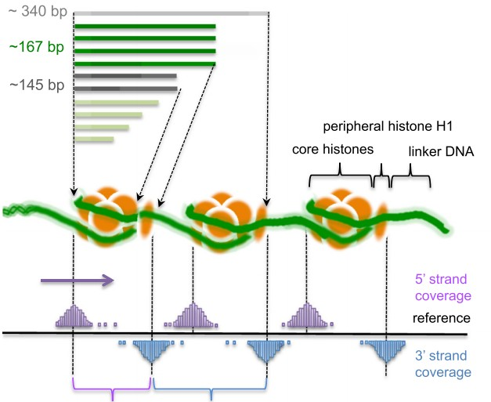
Complex mechanism of cell-free circulating DNA in human plasma
Non-random cleavage
Non-random releasing
The releasing process of DNA methylation to plasma is non-random
Methylation Haplotype can be used to distinguish different sample type and status

Slide 32
MONOD: Methylation Haplotype in non-invasive Cancer Diagnosis
Background
Material and Method
Result
Conclusion
Future work

Slide 33
Future works
Haplotype pattern Informative biomarker
Haplotype pattern in cancer, normal and FFPE samples
Intra-data Validation:
½ RRBS sample as train dataset and ½ RRBS sample as test dataset with 2-fold cross-validation
Inter-data Validation:
RRBS dataset as train dataset and BSPP data as test dataset
Independent data Validation:
TCGA dataset (TCGA and GEO dataset)
Total Dataset with imputation
RRBS, BSPP, SeqCap and GWBS were merged and missing value were imputed by KNN imputation. Random Forest with 5-fold cross-validation were applied in classification
Influence of the technique to MHL
24 samples were measured both with RRBS and BSPP

Slide 34
Figure 1. Characteristics and Genomic distribution of methylation blocks

Slide 35
Acknowledgment
Dinh Diep
Nongluk (Noi) Plongthongkum
Song Chen
Alice
Alan

Slide 36
Gene Ontology Analysis to 182 RRBS hyper-methylated genes
Table. Gene Function Enrichment analysis to 182 high frequent aberrant metylation with DAVID
Category | Term | Count | % | PValue | List Total | Pop Hits | Pop Total | Fold Enrichment | Benjamini
GOTERM_MF_FAT | transcription regulator activity | 30 | 19.48051948 | 4.63E-05 | 117 | 1512 | 12983 | 2.201702618 | 0.004415923
GOTERM_BP_FAT | regulation of transcription | 43 | 27.92207792 | 1.28E-05 | 117 | 2601 | 13528 | 1.911506751 | 0.005200761
GOTERM_BP_FAT | regulation of transcription, DNA-dependent | 34 | 22.07792208 | 9.09E-06 | 117 | 1773 | 13528 | 2.217266596 | 0.005536047
SP_PIR_KEYWORDS | dna-binding | 32 | 20.77922078 | 2.65E-05 | 148 | 1868 | 19235 | 2.226401991 | 0.006136452
GOTERM_MF_FAT | transcription factor activity | 23 | 14.93506494 | 4.46E-05 | 117 | 975 | 12983 | 2.617655052 | 0.006374167
GOTERM_BP_FAT | regulation of RNA metabolic process | 35 | 22.72727273 | 5.33E-06 | 117 | 1813 | 13528 | 2.232122232 | 0.006488715
GOTERM_MF_FAT | sequence-specific DNA binding | 18 | 11.68831169 | 2.65E-05 | 117 | 607 | 12983 | 3.29058421 | 0.007565542
SP_PIR_KEYWORDS | Homeobox | 10 | 6.493506494 | 1.04E-04 | 148 | 242 | 19235 | 5.370504802 | 0.011981548
SP_PIR_KEYWORDS | transcription regulation | 31 | 20.12987013 | 2.86E-04 | 148 | 2026 | 19235 | 1.988624236 | 0.021885309
SP_PIR_KEYWORDS | Transcription | 31 | 20.12987013 | 4.16E-04 | 148 | 2071 | 19235 | 1.945414149 | 0.023850767
INTERPRO | Homeobox | 10 | 6.493506494 | 1.87E-04 | 143 | 235 | 16659 | 4.957298021 | 0.03112568
GOTERM_BP_FAT | positive regulation of macromolecule biosynthetic process | 16 | 10.38961039 | 4.62E-04 | 117 | 654 | 13528 | 2.82872004 | 0.04592463
GOTERM_BP_FAT | positive regulation of nitrogen compound metabolic process | 16 | 10.38961039 | 3.93E-04 | 117 | 644 | 13528 | 2.872644264 | 0.046847505
GOTERM_BP_FAT | negative regulation of macromolecule metabolic process | 17 | 11.03896104 | 5.16E-04 | 117 | 734 | 13528 | 2.677938471 | 0.047376266
GOTERM_BP_FAT | positive regulation of gene expression | 15 | 9.74025974 | 4.43E-04 | 117 | 581 | 13528 | 2.985127322 | 0.048057813

Slide 37
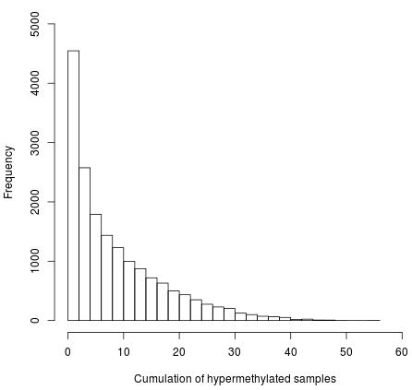
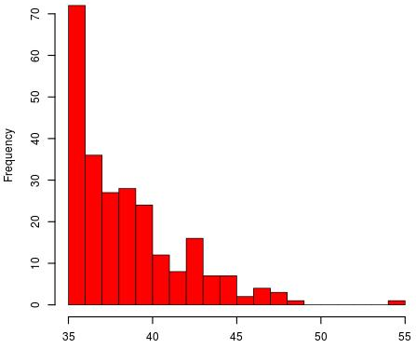
Result
248
56046
Actually, 248 hypermethylated regions occurred in at least 50% cancer samples. The average length of the regions is 103bp (IQR=95bp, SD=126). These regions located in the promoter region (TSS-2K) of 182 genes. 21 genes of them were defined as methylation relevant cancer related genes(NCBI).
TSS: Transcription Start Site; IQR: InterQuartile Range
Notes:
56046 regions were obtained by MLH algorithm and 17263 regions were 100% un-methylated in 8 normal samples. The optimal number of variables tried at each split is131(mtry) and number of trees (mtrees) makes no difference to the prediction accuracy from 500 to 7000. Random forest algorithm showed 1592 regions could provide positive ability to distinguish cancer samples from normal samples while the top 206 most importance regions could take account of 80.0% contribution, with sensitivity of 97.06%, specificity of 100% and accuracy of 97.37%. The second round prediction process of random forest model based on top 206 regions with mtry of 14 and mtrees of 500 showed 100% sensitivity, 100 specificity and 100% accuracy. One the other side, 248 regions were hypermethylated in at least 50% cancer samples. The average length of the regions were 103bp (IQR=95bp, SD=126) and were located in the promoter region of 182 genes (2000bp up-stream of TSS). With the help of text mining, 21 genes of them were validated to be methylation relevant cancer related genes (Table).

Slide 38
248
RRBS
RRBS
Cap-Seq
Cap-Seq
56046
BBSP
BBSP
RRBS
RRBS
Cap-Seq
Cap-Seq
BBSP
BBSP

Slide 39
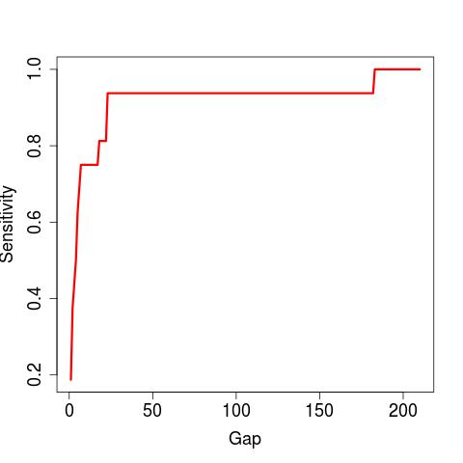
Shared hypermethylated DNA regions from RRSB and SeqCap were collected and the methylation status of these regions were validated in BSPP dataset. We need do intersection operation for 3 times and the distance (Gap) between the two regions which is less < gap were taken as the same biomarker. Obviously, Gap=25 is the best option to do the bed intersection operation.

Slide 40
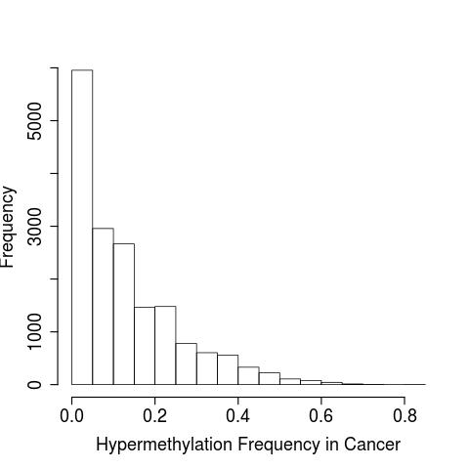
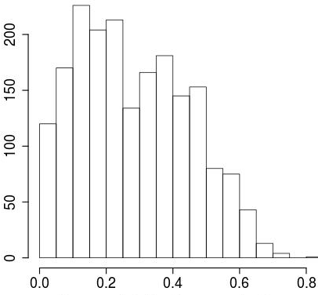
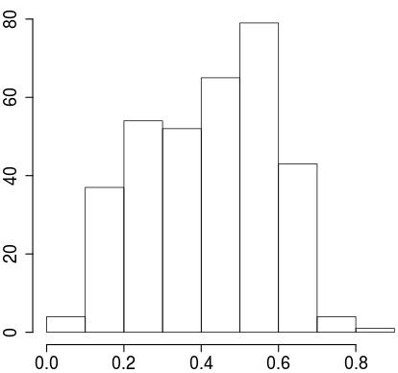

Slide 41
Enrollment
Plasma Collection
DNA extraction
Bisulfite Conversion
Sequencing
Raw Data
Alignment
Methylation LD Block
Methylation Haplotype
Loading Calculation

Slide 42
The mutation ratio for significant genes are very high, ranging from 2.43% to 47.57%. However, the mutation rate for specific site is very low, there are up to 139 mutations in TP53 occurred in 196 patients, each patients have 1.41 mutations.
Gene | All Samples (n=412) # mutated patients | All Samples (n=412) # mutated sites | p-value | q-value | Bonferroni p-value | Mutation Patient Ratio | Mutation Sites/Patients
TP53 | 196 | 139 | 1.00E-16 | 4.05E-13 | 1.83E-12 | 47.57% | 1.41
KRAS | 115 | 9 | 1.00E-16 | 4.05E-13 | 1.83E-12 | 27.91% | 12.78
EGFR | 64 | 40 | 1.00E-16 | 4.05E-13 | 1.83E-12 | 15.53% | 1.60
STK11 | 64 | 53 | 1.00E-16 | 4.05E-13 | 1.83E-12 | 15.53% | 1.21
RBM10 | 30 | 29 | 1.11E-16 | 4.05E-13 | 2.03E-12 | 7.28% | 1.03
CDKN2A | 18 | 16 | 2.99E-14 | 8.60E-11 | 5.46E-10 | 4.37% | 1.13
KEAP1 | 61 | 58 | 3.30E-14 | 8.60E-11 | 6.02E-10 | 14.81% | 1.05
BRAF | 36 | 22 | 5.11E-12 | 1.17E-08 | 9.33E-08 | 8.74% | 1.64
U2AF1 | 13 | 2 | 1.74E-11 | 3.53E-08 | 3.18E-07 | 3.16% | 6.50
SMARCA4 | 33 | 34 | 3.13E-11 | 5.71E-08 | 5.71E-07 | 8.01% | 0.97
NF1 | 45 | 52 | 4.83E-11 | 8.02E-08 | 8.82E-07 | 10.92% | 0.87
MET | 24 | 22 | 9.67E-10 | 1.47E-06 | 1.77E-05 | 5.83% | 1.09
ARID1A | 31 | 34 | 1.47E-09 | 2.06E-06 | 2.68E-05 | 7.52% | 0.91
SETD2 | 29 | 37 | 1.73E-09 | 2.25E-06 | 3.16E-05 | 7.04% | 0.78
RB1 | 16 | 16 | 1.54E-08 | 1.88E-05 | 0.000281096 | 3.88% | 1.00
PIK3CA | 23 | 13 | 8.24E-08 | 9.40E-05 | 0.001504047 | 5.58% | 1.77
MGA | 25 | 29 | 5.35E-07 | 5.74E-04 | 0.009765355 | 6.07% | 0.86
RIT1 | 10 | 8 | 1.07E-06 | 1.09E-03 | 0.01953071 | 2.43% | 1.25
Comprehensive molecular profiling of lung adenocarcinoma. Nature. 2014, 511(7511):543-50

Slide 43
Figure 1. High frequent aberrant hypermethylated genes in RRBS dataset
 | Gene Symbol | Gene ID |  | Chrosome | Start | End | orientation | exon_count | OMIM
1 | JAM3 | 83700 | 11q25 | 11 | 134068925 | 134151757 | plus | 9 | 606871
2 | TMEFF2 | 23671 | 2q32.3 | 2 | 191949046 | 192194940 | minus | 10 | 605734
3 | MTSS1 | 9788 | 8p22 | 8 | 124550770 | 124728507 | minus | 19 | 608486
4 | L3MBTL1 | 26013 | 20q13.12 | 20 | 43507680 | 43541895 | plus | 22 | 608802
5 | IRF4 | 3662 | 6p25-p23 | 6 | 391739 | 411443 | plus | 10 | 601900
6 | CCDC181 | 57821 | 1q24 | 1 | 169394870 | 169460669 | minus | 8
7 | IGF2 | 3481 | 11p15.5 | 11 | 2129112 | 2149603 | minus | 9 | 147470
8 | IGF2-AS | 51214 | 11p15.5 | 11 | 2140528 | 2148666 | plus | 2 | 610146
9 | CCNA1 | 8900 | 13q12.3-q13 | 13 | 36431030 | 36442882 | plus | 11 | 604036
10 | GATA2 | 2624 | 3q21.3 | 3 | 128479422 | 128493187 | minus | 8 | 137295
11 | NTRK2 | 4915 | 9q22.1 | 9 | 84668458 | 85027070 | plus | 23 | 600456
12 | DLEC1 | 9940 | 3p21.3 | 3 | 38038605 | 38122737 | plus | 38 | 604050
13 | ALX4 | 60529 | 11p11.2 | 11 | 44260438 | 44319220 | minus | 7 | 605420
14 | CBX3 | 11335 | 7p15.2 | 7 | 26201211 | 26213607 | plus | 8 | 604477
15 | CYP26B1 | 56603 | 2p13.2 | 2 | 72129238 | 72147862 | minus | 8 | 605207
16 | NFATC1 | 4772 | 18q23 | 18 | 79395772 | 79529323 | plus | 11 | 600489
17 | DNMT3A | 1788 | 2p23 | 2 | 25232961 | 25342590 | minus | 33 | 602769
18 | ITGA4 | 3676 | 2q31.3 | 2 | 181456892 | 181537747 | plus | 28 | 192975
19 | GATA4 | 2626 | 8p23.1-p22 | 8 | 11676924 | 11760001 | plus | 12 | 600576
20 | SLC5A5 | 6528 | 19p13.11 | 19 | 17871411 | 17895174 | plus | 16 | 601843
21 | PHACTR3 | 116154 | 20q13.32-q13.33 | 20 | 59577509 | 59847711 | plus | 18 | 608725

Slide 44
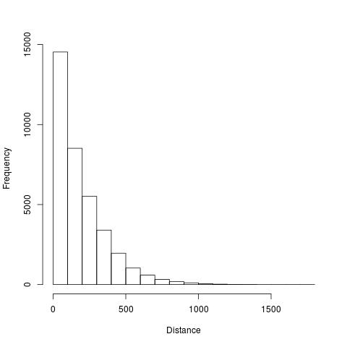
Histogram distribution of the MHL regions of BSPP dataset. 63.4% MHL distance of BSPP were less than 200bp, indicating they are almost located in the same region/CpG island in human genome, therefore, we need merge these MHL region together to increase the sensitivity of the prediction. In other words, when can do bed intersection operation wth certain gaps so that these regions can be selected.

Slide 45
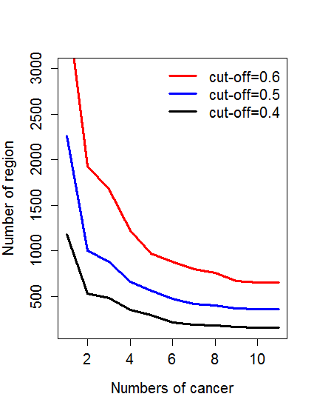
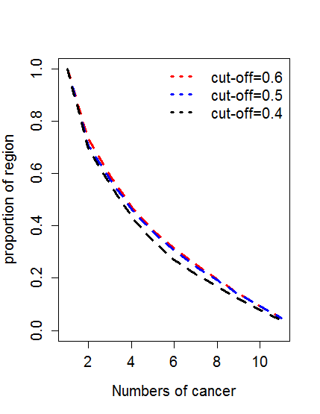
Notes:
【left】
number4<-c(3734,1926,1679,1220,965,878,795,755,665,654,654)
number5<-c(2260,999, 880, 655, 563,471,415,401,366,357,357)
number6<-c(1181,529, 480, 350, 291,211,184,176,164,155,155)
plot(number4,type="l",lwd=3,col="red",ylim=c(150,3000),xlab="Numbers of cancer",ylab="Number of region",cex.axis=1.25,cex.lab=1.25)
lines(number5,lwd=3,col="blue")
lines(number6,lwd=3,col="black")
legend("topright",legend=c("cut-off=0.6","cut-off=0.5","cut-off=0.4"),col=c("red","blue","black"),lwd=3,lty=1,bty="n",cex=1.25)
【Right】
number4<-rev(c(3734,1926,1679,1220,965,878,795,755,665,654,654))
number5<-rev(c(2260,999, 880, 655, 563, 471, 415, 401, 366, 357, 357))
number6<-rev(c(1181,529, 480, 350, 291, 211, 184, 176, 164, 155, 155))
number4<-rev(cumsum(number4)/sum(number4))
number5<-rev(cumsum(number5)/sum(number5))
number6<-rev(cumsum(number6)/sum(number6))
plot(number4,type="l",lwd=3,lty=2,col="red",ylim=c(0,1),xlab="Numbers of cancer",ylab="Number of region",cex.axis=1.25,cex.lab=1.25)
lines(number5,lwd=3,lty=2,col="blue")
lines(number6,lwd=3,lty=2,col="black")
legend("topright",legend=c("cut-off=0.6","cut-off=0.5","cut-off=0.4"),col=c("red","blue","black"),lwd=3,lty=3,bty="n",cex=1.25)

Slide 48
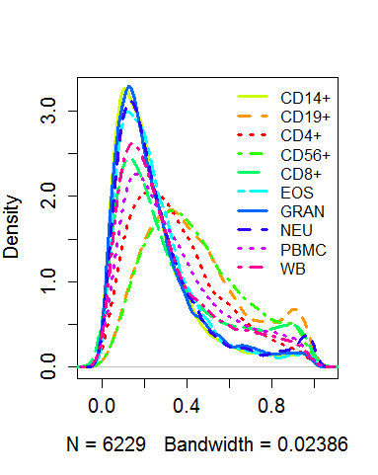
Genome-wide DNA methylation Profile in the elements of whole blood
Obviously,
1, CD4+, CD8+ and CD56 were cluster together.
2, Eos, Gran, Neu were cluster together
3, whole blood and PBMC were mixed by these cells

Slide 49
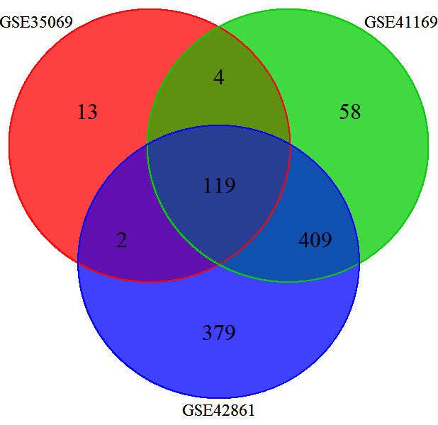
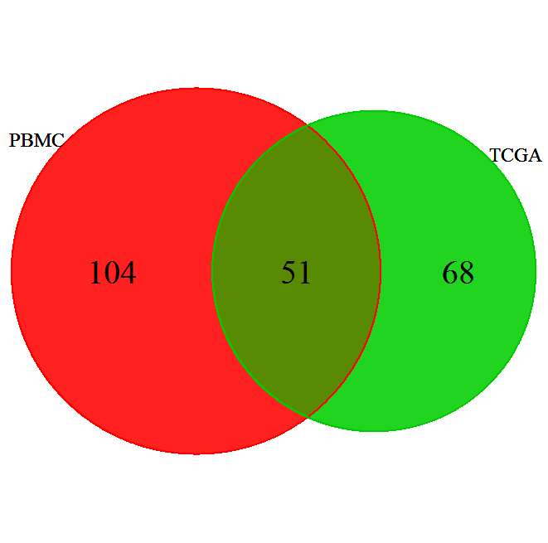
TCGA
32.9%-41.9%
GSE35069:Differential DNA Methylation in Purified Human Blood Cells (CD4+,CD8+,CD19+)
GSE41169:Blood DNA methylation profiles in a Dutch population (62 schizophrenia and 33 normal )
GSE42861:Differential DNA methylation in the PBMC from 354 Rheumatoid arthritis and 337 normal

Slide 50
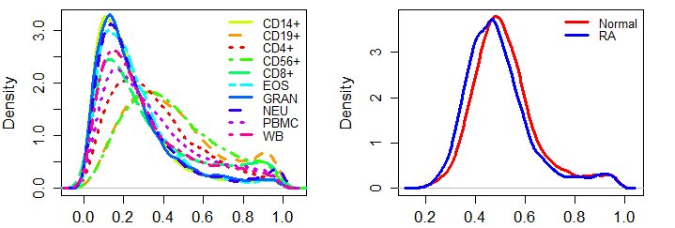

Slide 51
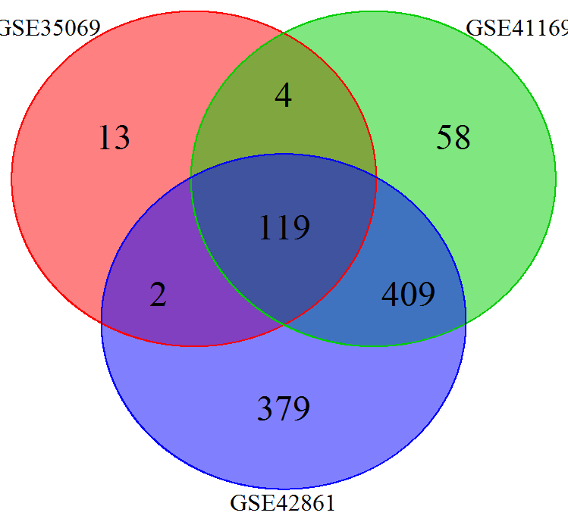

Slide 52
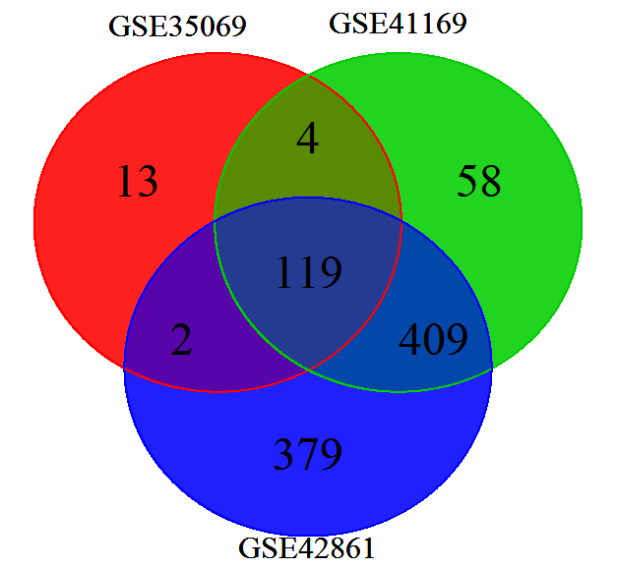
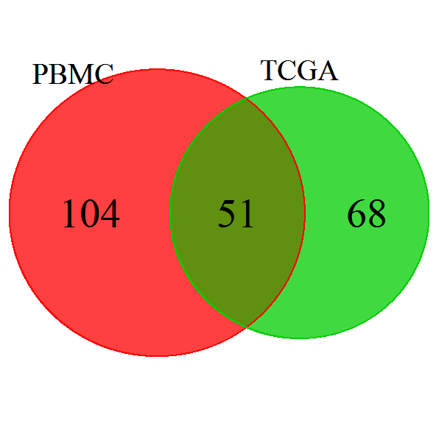
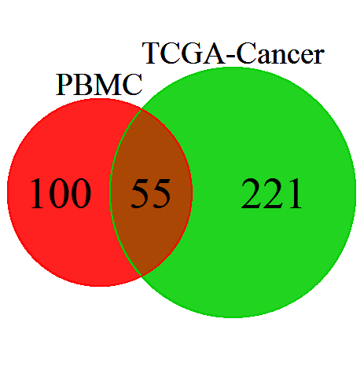

Slide 54
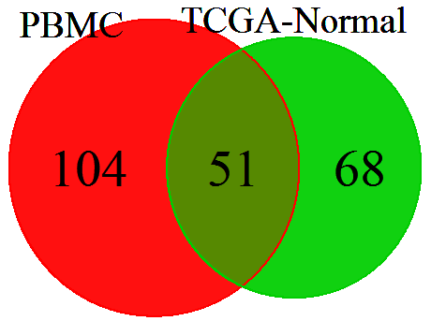

Slide 55
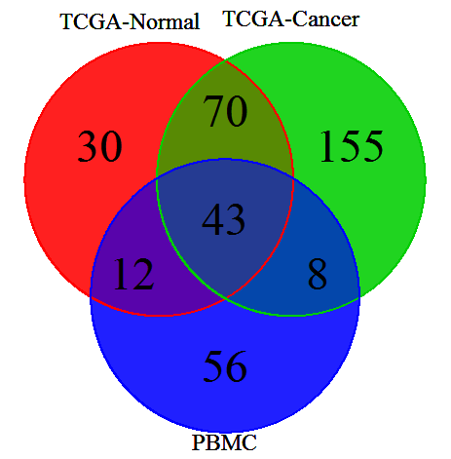

Slide 57
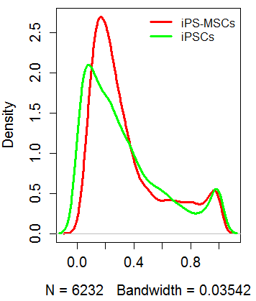

Slide 58
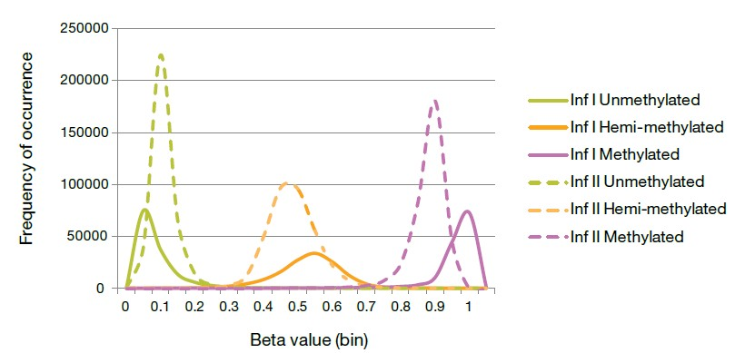

Slide 60
Bis-SNP: Combined DNA methylation and SNP calling for Bisulfite-seq data
Bismark： A tool to map bisulfite converted sequence reads and determine cytosine methylation states
BSeQC
What’s LambdaDNA?
http://genome-tech.ucsd.edu/LabNotes/index.php/Dinh/Dinh_2015/NOTES/2015-1-7
http://genome-tech.ucsd.edu/LabNotes/index.php/Jeff:LabNotes/Microbiome/2011-9-16

Slide 61



Slide 62


Slide 63


Background adjustment

Slide 64



Slide 66




Slide 67


MHL distribution and variation in WGBS dataset
Methylation haplotype loading in majority non-cancer samples were very small.

Slide 68
Mid-Summary
Methylation Blocks were conserved in different dataset and cancers
Methylation Blocks screening in methylation 450K
1, compare with different cancers
2, compare with methylation block derived from WGBS

Slide 69
Figure 1. high density CpG regions in 450K array normal samples
Notes:
For different cancer dataset, the number of the high density CpG region (HDR) were slightly different because some probes might totally or majority missed in the dataset and these probes were removed and then to find the HDR. From the HDR analysis, you could find that there is not significant difference for the number of the HDR in different cancer dataset. the number of the HDR in all the 11 dataset ranged from 4858 to 5290. The average length of the HDR is 171bp (IQR=117bp) and the average distance between neighbor CpG site is about 27bp(IQR=13bp). the average number of the CpG site in the HDR is 6 (range from 5 to 50).

Slide 70
Methylation Blocks were conserved in different cancers and dataset
Total methylation block in meth450: 2421, 59.97% (maybe more with raw methylation regions)were occurred in WGBS methylation blocks (P<10⁻⁹, random shuffling), indicating these regions were conserved between methylation 450K and WGBS
Exponential decay was not found as the increase of the cancers
Notes:
【left】
number4<-c(3734,1926,1679,1220,965,878,795,755,665,654,654)
number5<-c(2260,999, 880, 655, 563,471,415,401,366,357,357)
number6<-c(1181,529, 480, 350, 291,211,184,176,164,155,155)
plot(number4,type="l",lwd=3,col="red",ylim=c(150,3000),xlab="Numbers of cancer",ylab="Number of region",cex.axis=1.25,cex.lab=1.25)
lines(number5,lwd=3,col="blue")
lines(number6,lwd=3,col="black")
legend("topright",legend=c("cut-off=0.6","cut-off=0.5","cut-off=0.4"),col=c("red","blue","black"),lwd=3,lty=1,bty="n",cex=1.25)
【Right】
number4<-rev(c(3734,1926,1679,1220,965,878,795,755,665,654,654))
number5<-rev(c(2260,999, 880, 655, 563, 471, 415, 401, 366, 357, 357))
number6<-rev(c(1181,529, 480, 350, 291, 211, 184, 176, 164, 155, 155))
number4<-rev(cumsum(number4)/sum(number4))
number5<-rev(cumsum(number5)/sum(number5))
number6<-rev(cumsum(number6)/sum(number6))
plot(number4,type="l",lwd=3,lty=2,col="red",ylim=c(0,1),xlab="Numbers of cancer",ylab="Number of region",cex.axis=1.25,cex.lab=1.25)
lines(number5,lwd=3,lty=2,col="blue")
lines(number6,lwd=3,lty=2,col="black")
legend("topright",legend=c("cut-off=0.6","cut-off=0.5","cut-off=0.4"),col=c("red","blue","black"),lwd=3,lty=3,bty="n",cex=1.25)

Slide 71
Supplementary： Methylation Blocks were conserved between Normal PBMC and Tissues
TCGA
32.9%-41.9%
GSE35069:Differential DNA Methylation in Purified Human Blood Cells (CD4+,CD8+,CD19+)
GSE41169:Blood DNA methylation profiles in a Dutch population (62 schizophrenia and 33 normal )
GSE42861:Differential DNA methylation in the PBMC from 354 Rheumatoid arthritis and 337 normal
Note: GSE42861 need re-analysis after remove probes from ChrX and ChrY

Slide 72
More Cancer Specific Methylation regions were identified by methylation blocks
Figure 1. Comparison of the correlation for the high density CpG regions in 450K array between cancer and normals

Slide 73
Figure . Comparison of the correlation for the high density CpG regions in 450K array between cancer and normals

Slide 74


WGBS and RRBS also revealed large number hypermethylated regions
WGBS dataset
RRBS dataset

Slide 75


Relationship between samples based on GWBS dataset with PCA and Hierarchical Clustering

Slide 76


R Script for methylation entropy and simulation performance
ME=0 ME=0 ME=0.25 ME=1
Find some classic genes/regions to show the difference between MHL and ME

Slide 77
Characteristic and genome distribution of Methylation block
Entropy calculation, Heterogeneity
Enhancer, promoter, exon, intron, 5-UTR, 3-UTR, miRNA, lncRNA and so on

Slide 78

SeqCap dataset

Slide 79


Distribution of Methylation block in human genomics

Slide 80




Methylation block inferred from RRBS and microarray dataset
Array: Fold change: 23.4, P-value<1.0 × 10⁻⁸
RRBS: Fold change: 19.8, P-value<1.0 × 10⁻⁶
P-value<2.2 × 10⁻⁶
P-value<2.2 × 10⁻⁶

Slide 82



Slide 83




Slide 84


Slide 85


Methylation Blocks In RRBS dataset from Encode Project

